Slide 1

Ramen Ratings Over 2500 ramen ratings

Slide 2
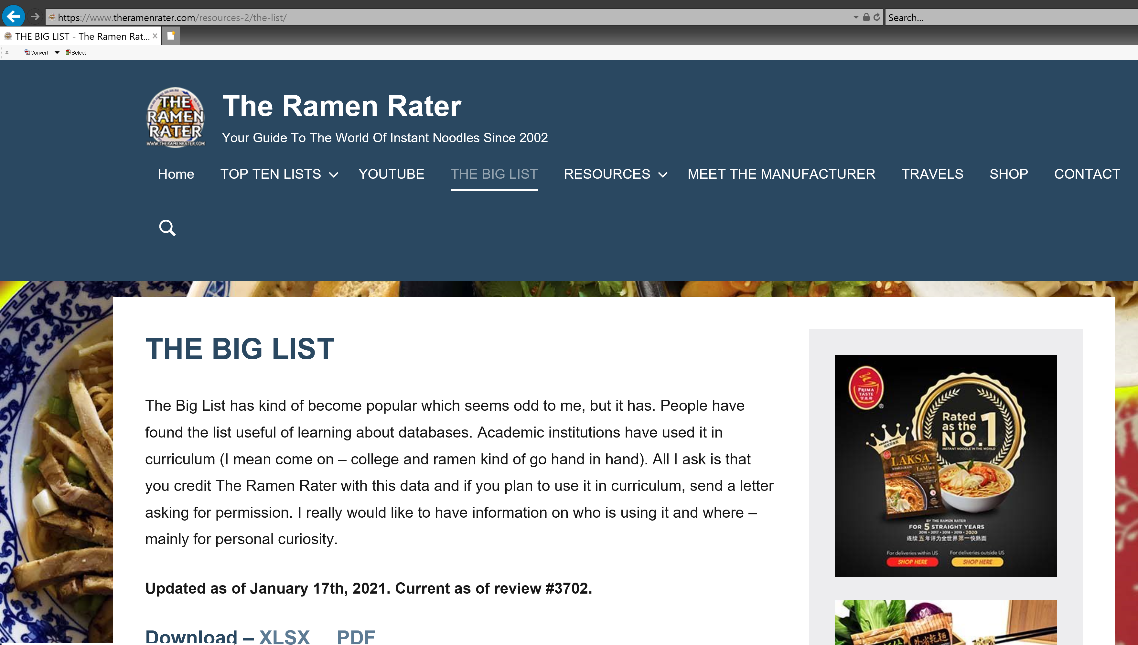
The Ramen Rater https://www.theramenrater.com/ is a product review website for the hardcore ramen enthusiast (or "ramenphile"), with over 2500 reviews to date. This dataset is an export of "The Big List" (of reviews), converted to a CSV format.

Slide 3
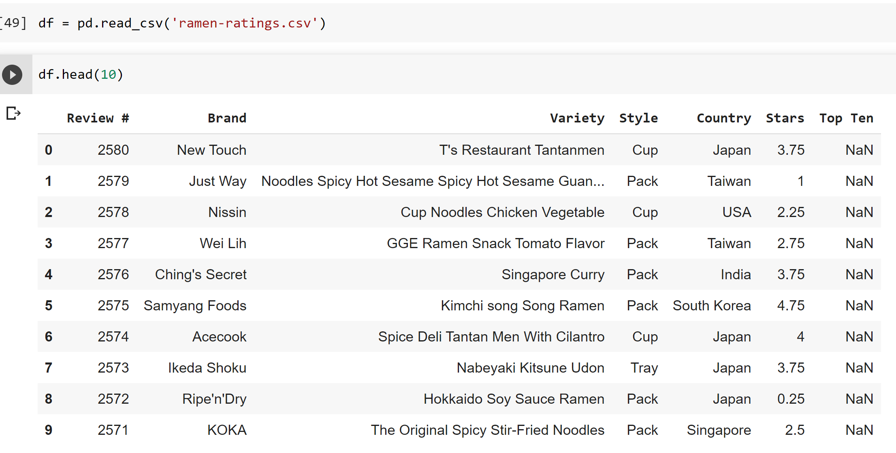
Target
Each record in the dataset is a single ramen product review.
Review numbers are contiguous: more recently reviewed ramen varieties have higher numbers.
Brand, Variety (the product name), Country, and Style (Cup, Bowl, Tray) are pretty self-explanatory.
Stars indicate the ramen quality, as assessed by the reviewer, on a 5-point scale; this is the most important column in the dataset

Slide 4
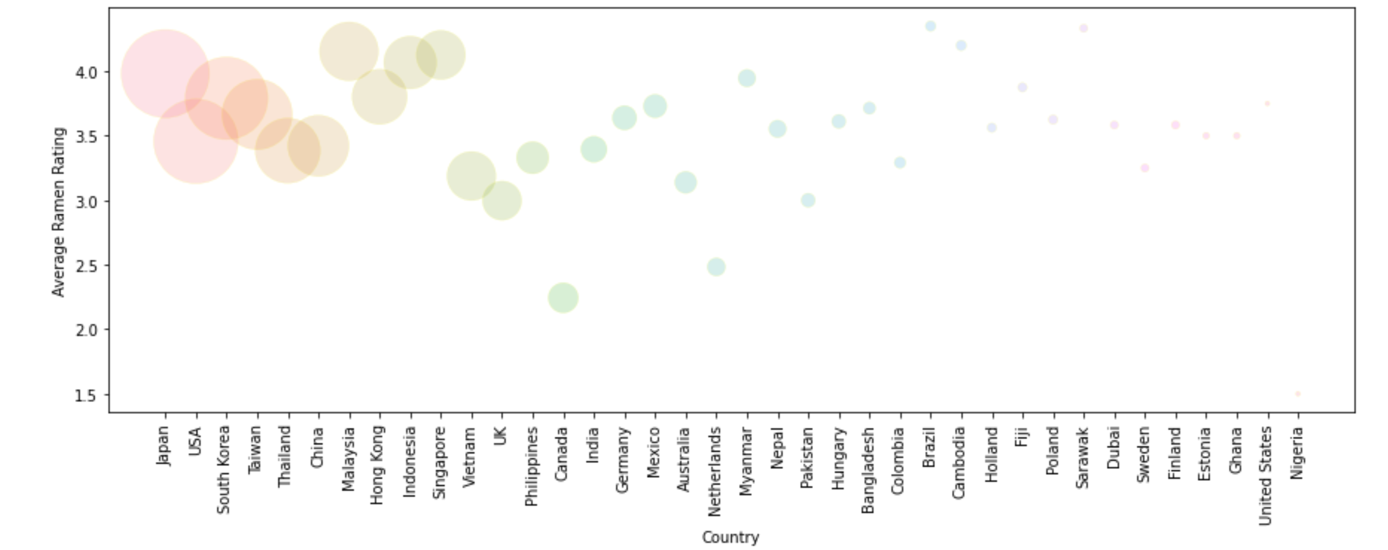
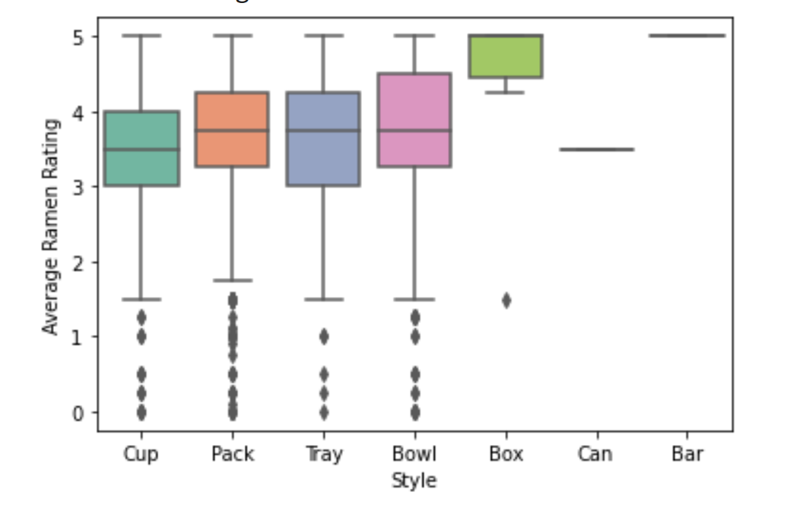
Data Preparation and Exploratory Data Analysis
Av
Data Preparation of stars -> replace ‘Unrated’ with np.nan
convert ‘Stars’ columns to numeric
The Average reman Rating Per Country
Average Ramen Rating Per Stlye
How many remens produced Per Country

Slide 5
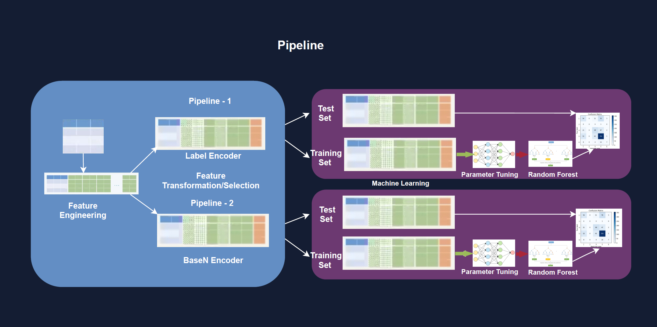
https://github.com/joycebzhang/reman_rating

Slide 6
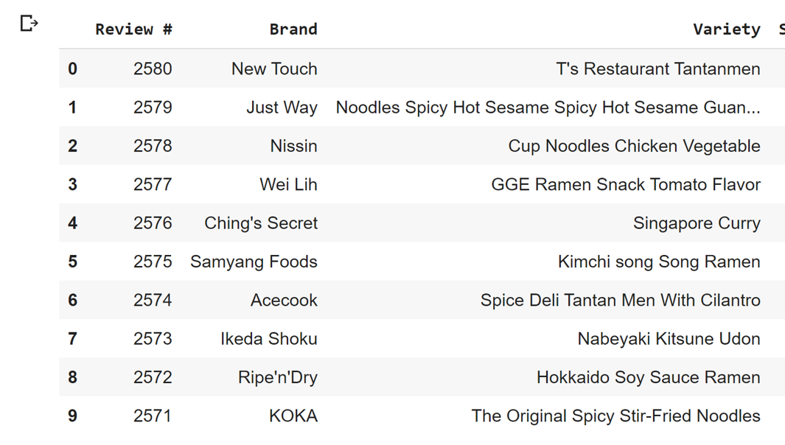
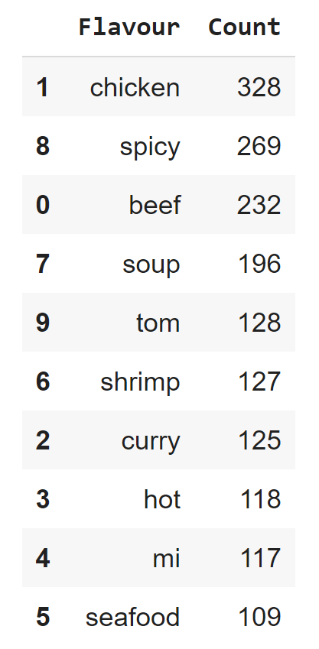
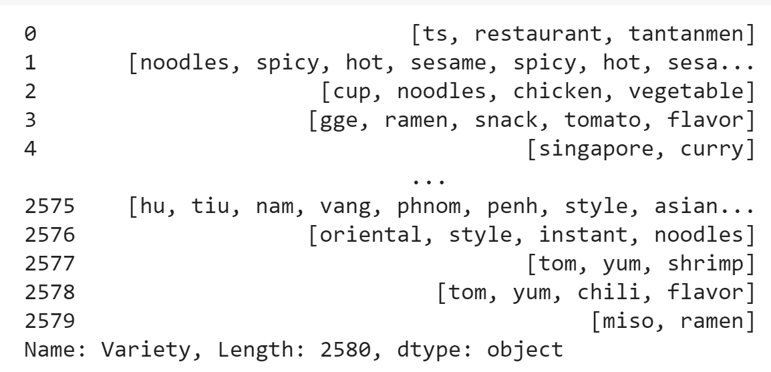
Feature Extraction from Variety column
Remove the punctuation
Remove stopwords
such as 'the', 'and' etc.
Tokenize
Joins all the words in all the rows

Slide 7
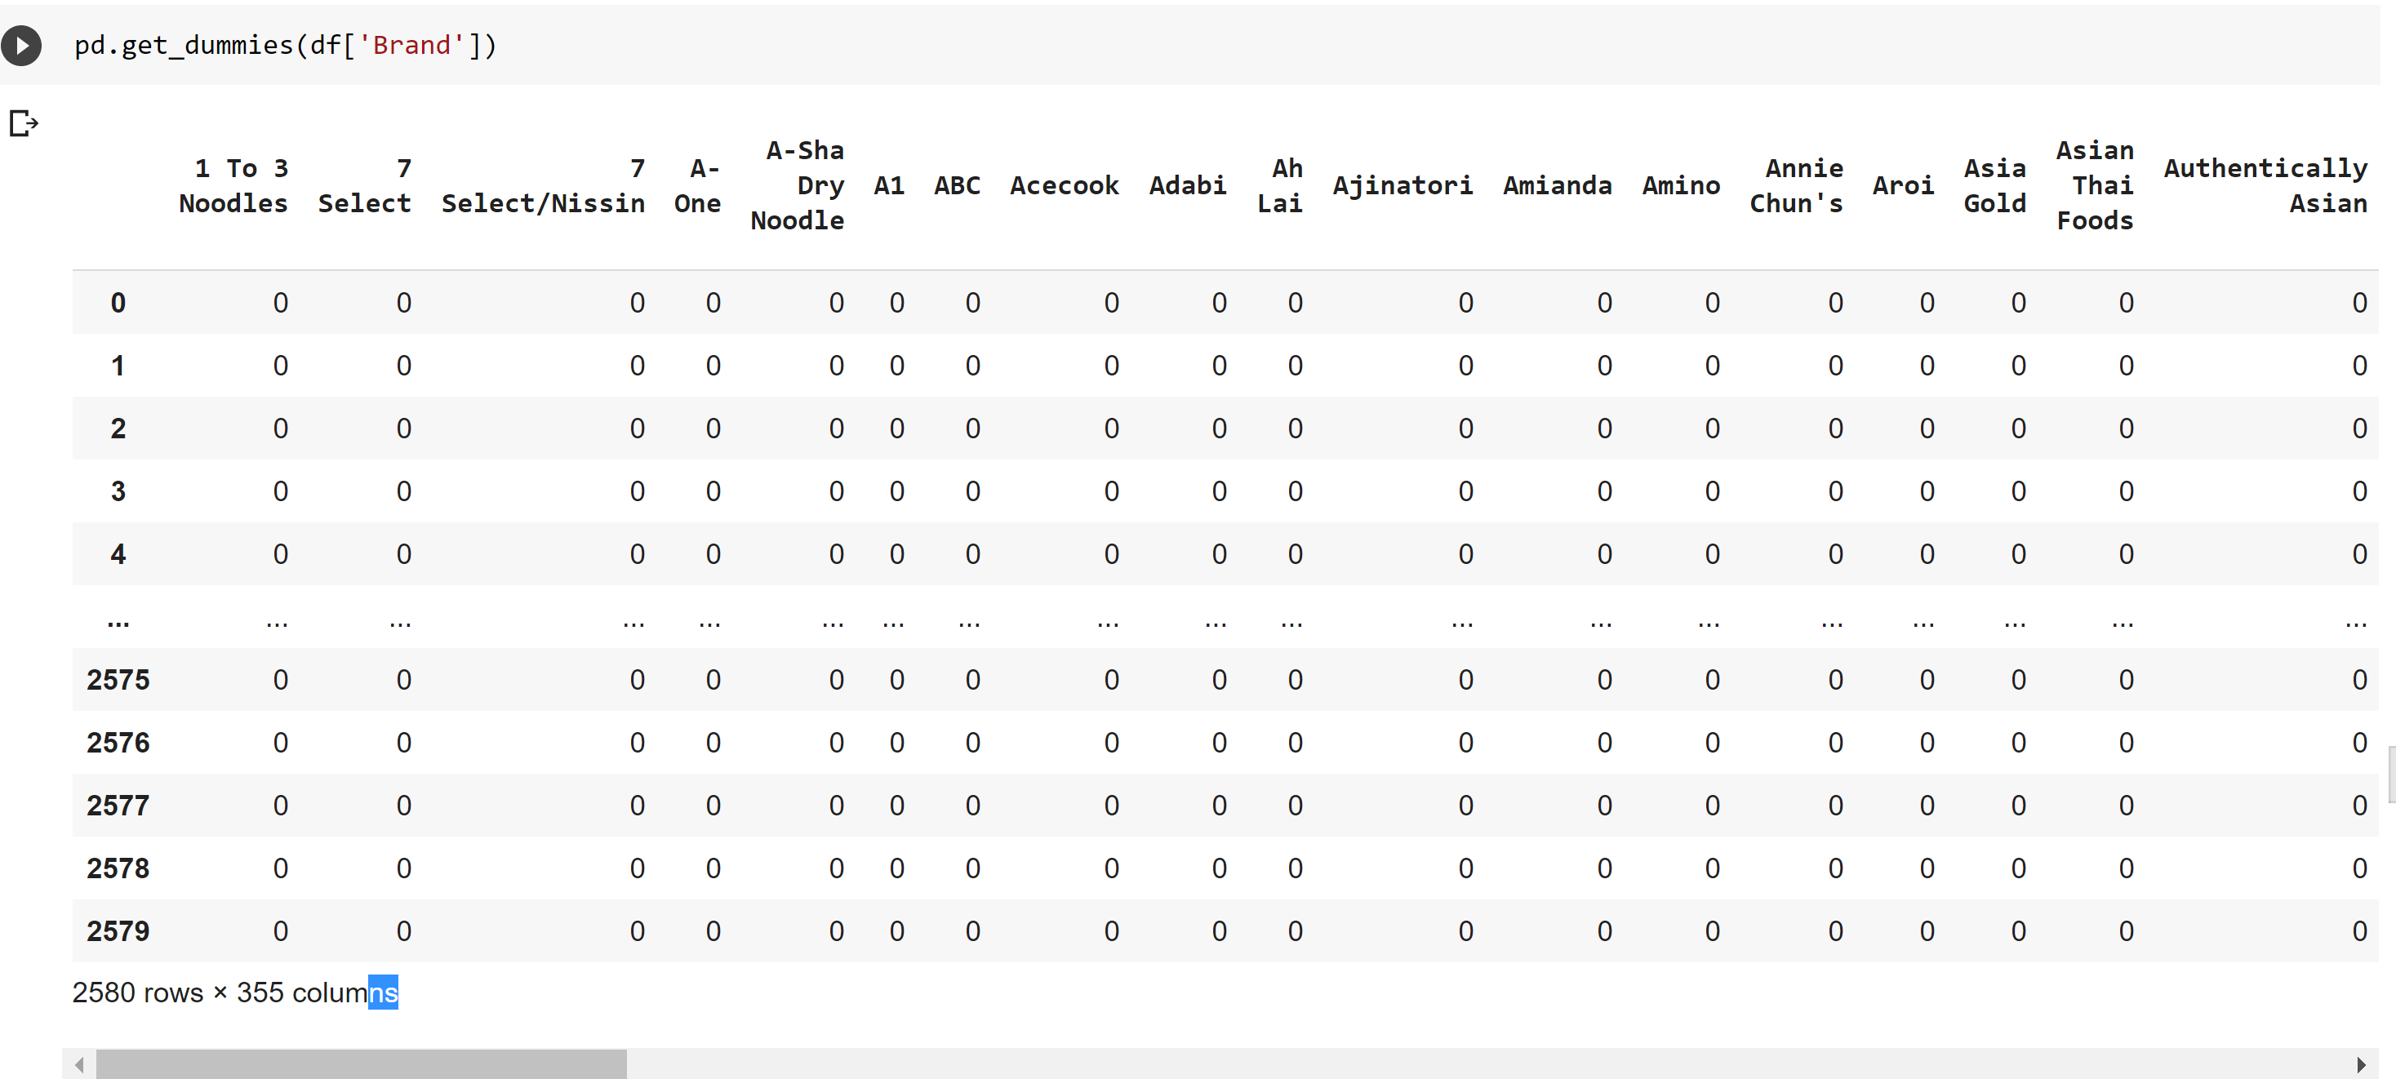
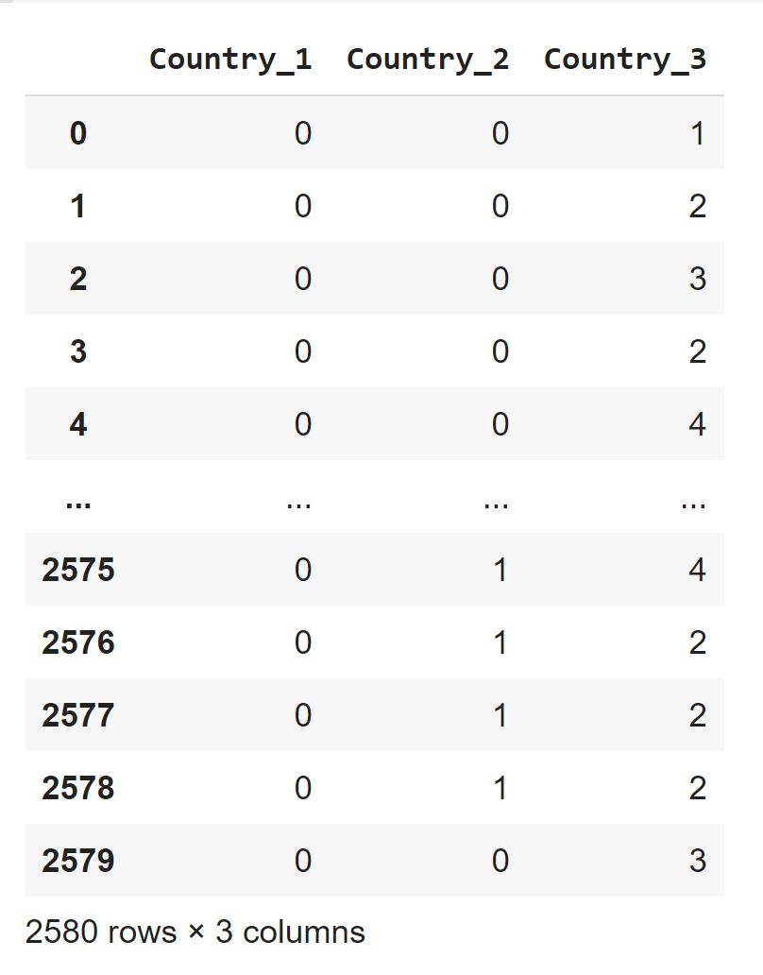
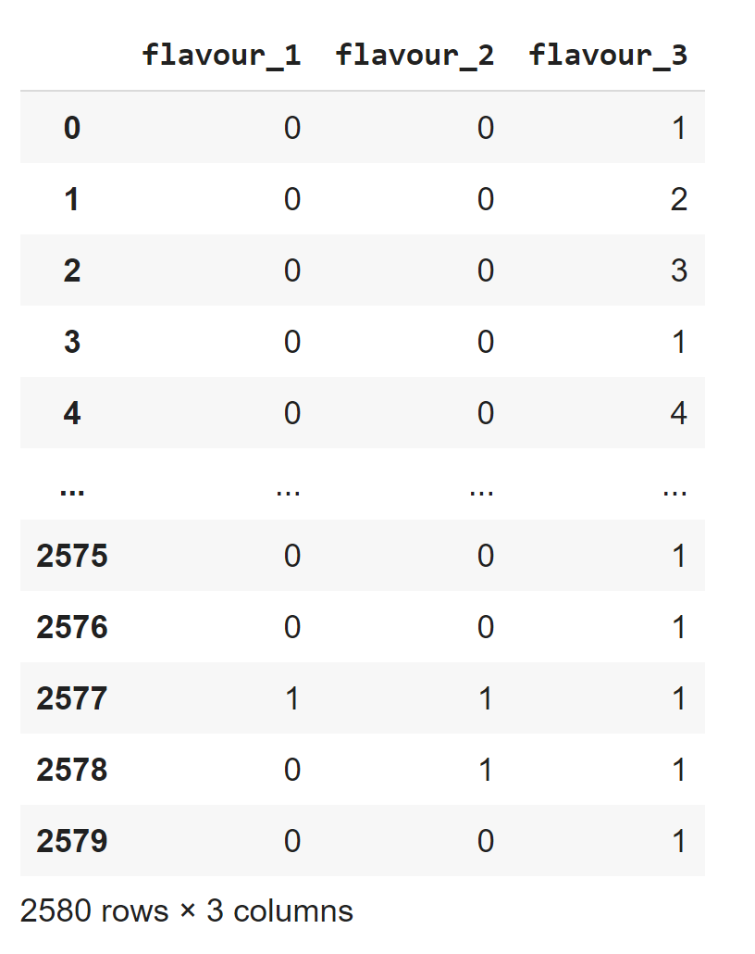
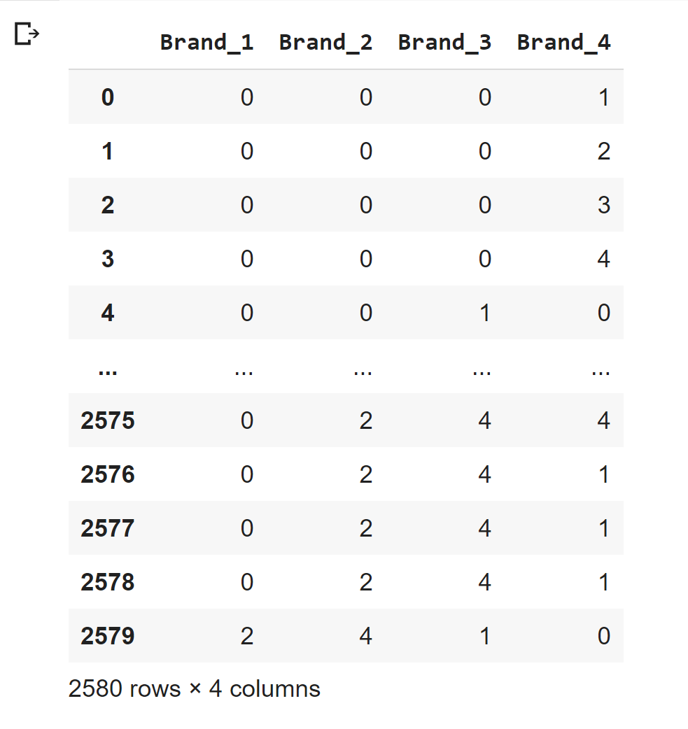
Base-N encoder
38 Countries
10 Flavour
355 Brands

Slide 8
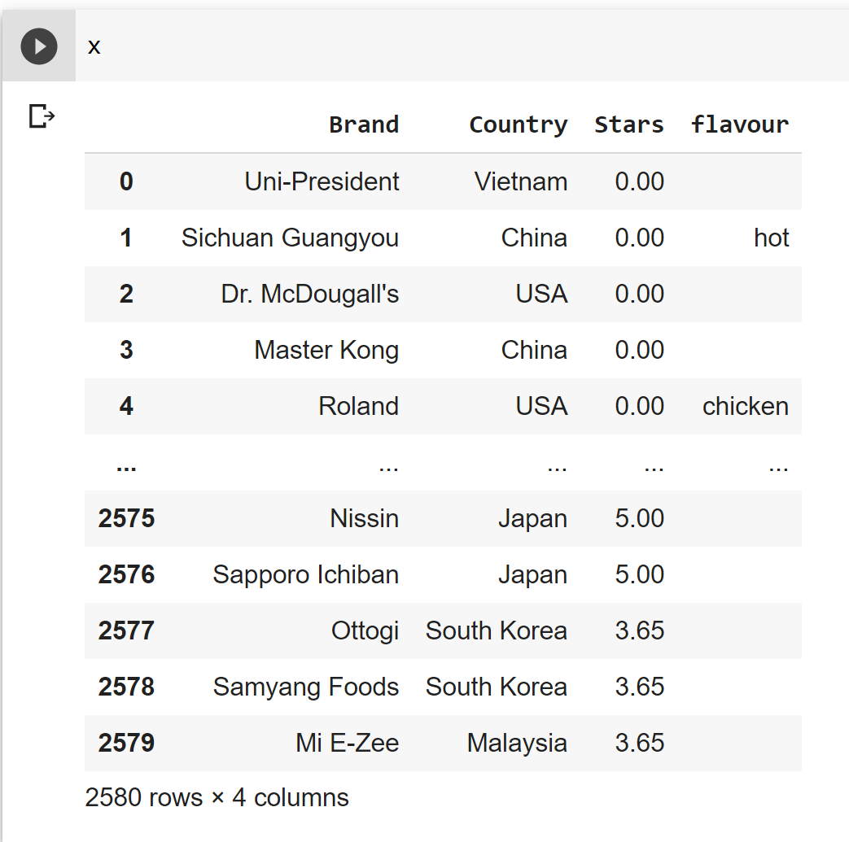
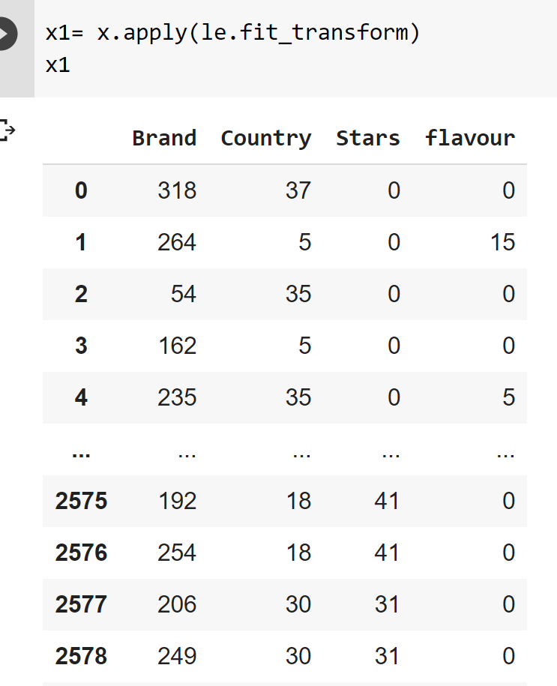

Slide 9
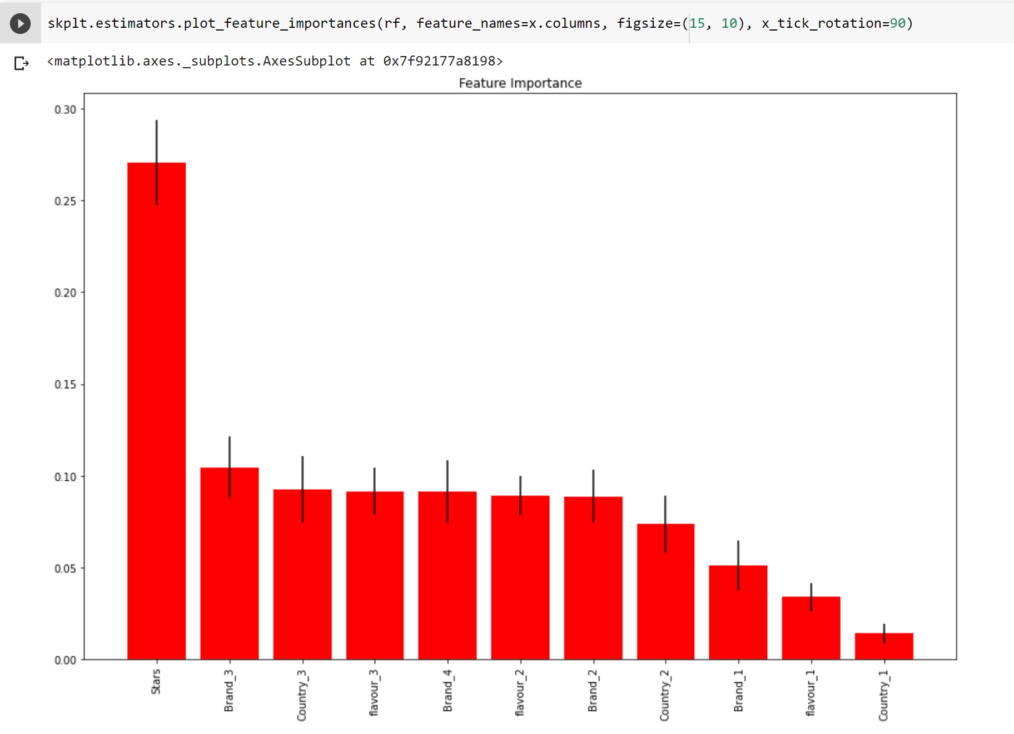
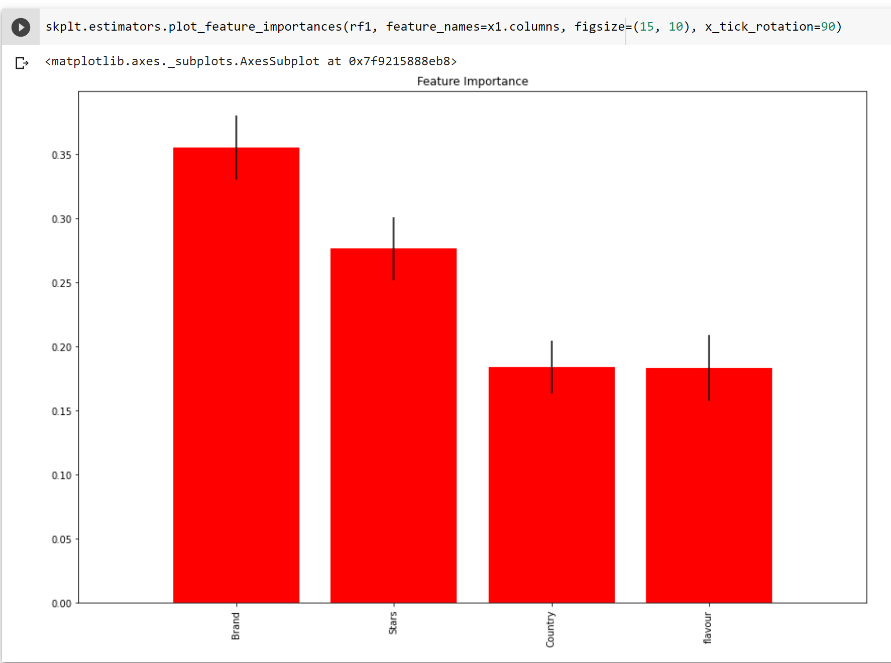

Slide 10
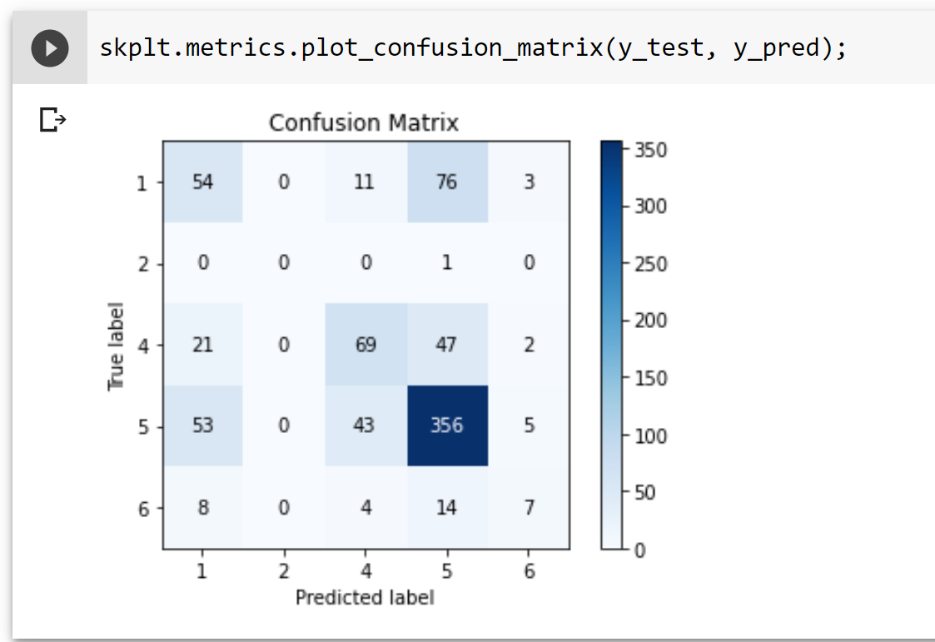
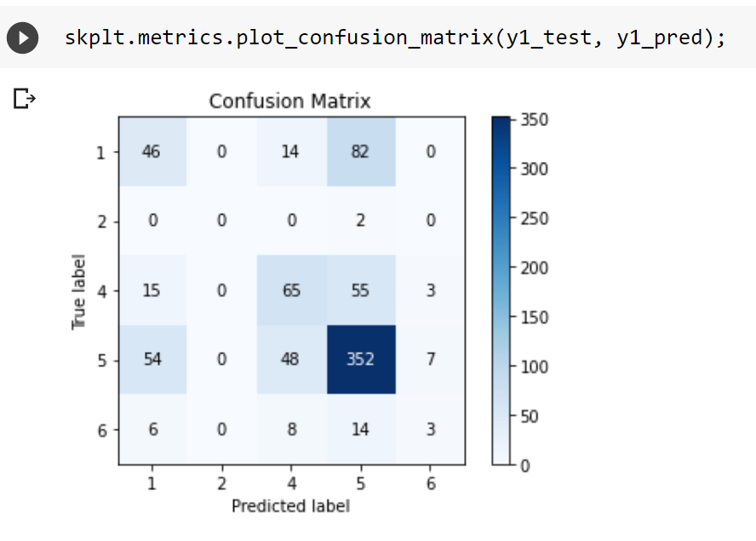
https://github.com/joycebzhang/reman_rating

